Slide 1
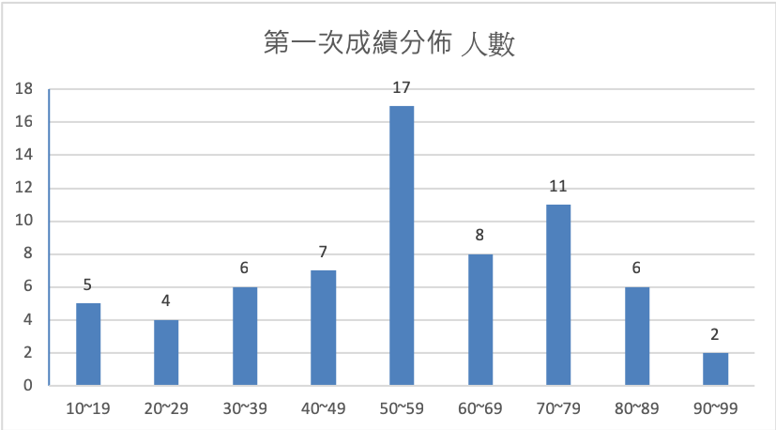
Max: 97 Avg: 55

Slide 2
c
a d

Slide 3
Define the following terms: (a) data model (b) superkey (c) naïve or parametric end-users (d) internal schema. (20%)
In case of integrity violation in update operations on relations, please describe what actions can be taken? (10%)

Slide 4
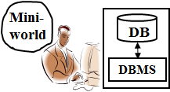
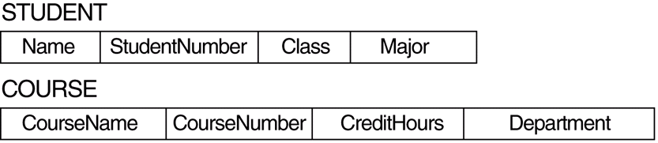
Data Models
Data Model
A set of concepts to describe the structure of a database, and certain constraints that the database should obey.
ER data model: {entity, relationship, attribute, key, …}
Relational data model: {relation, tuple, attribute, primary key, …}
SID
STUDENT
Name
m
Schema by
ER data model
TAKE
n
CID
COURSE
Schema by
Relational data model

Slide 5
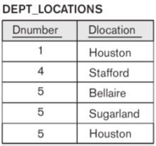
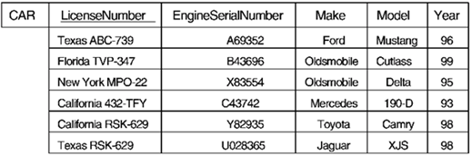
Key Constraints
Superkey of R:
A set of attributes SK of R such that no two tuples in any valid relation instance r(R) will have the same value for SK.
For any distinct tuples t1 and t2 in r(R), t1[SK] ≠ t2[SK].
SK={LicenseNumber}?, SK={Make}?, SK={LicenseNumber, Make}?
Key of R:
A "minimal" superkey;
A superkey K such that removal of any attribute from K results in a set of attributes that is not a superkey.
Key1 = {LicenseNumber}, Key2 = {EngineSerialNumber}
are two keys of relation CAR; Key = {Dnumber, Dlocation}
SK1={EngineSerialNumber, Make}, SK2={LicenseNumber, Make, Year}
are superkeys but not keys
t1
t2

Slide 6

Categories of End-users-1
Naïve or Parametric
They use previously well-defined functions in the form of “canned transactions” against the database.
Examples are bank-tellers or reservation clerks who do this activity for an entire shift of operations.

Slide 7
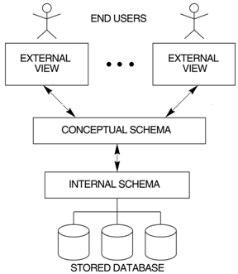
Three-Schema Architecture
Defines DBMS schemas at three levels:
External schemas
at the external level to describe the various user views. Usually uses the same data model as the conceptual level.
Conceptual schema
at the conceptual level to describe the structure and constraints for the whole database for a community of users. Uses a conceptual or an implementation data model.
Internal schema
at the internal level to describe physical storage structures and access paths. Typically uses a physical data model.
DBA defines DB schema

Slide 8
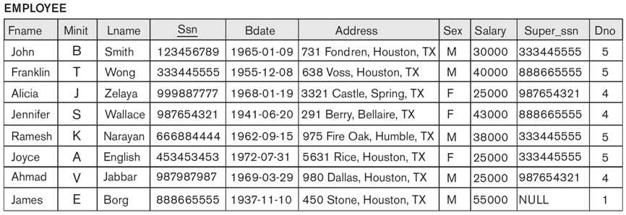
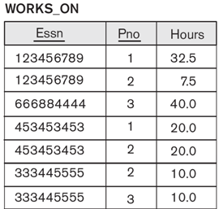
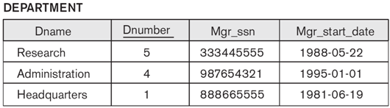
Update Operations on Relations
In case of integrity violation, several actions can be taken:
Cancel the operation that causes the violation (REJECT option)
Perform the operation but inform the user of the violation
Trigger additional updates so the violation is corrected (CASCADE option, SET NULL option, SET DEFAULT option)
Execute a user-specified error-correction routine
(PK)
(FK)
(FK)
Delete
Modify
(PK)
(FK)
(FK)
(FK)

Slide 9


Slide 10
When not to Use a DBMS
Main inhibitors (costs) of using a DBMS:
High initial investment and possible need for additional hardware.
Overhead for providing generality, security, concurrency control, recovery, and integrity functions.
When a DBMS may be unnecessary:
If the database and applications are simple, well defined, and not expected to change.
If there are stringent real-time requirements that may not be met because of DBMS overhead.
If access to data by multiple users is not required.
When no DBMS may suffice:
If the database system is not able to handle the complexity of data because of modeling limitations
If the database users need special operations not supported by the DBMS.

Slide 11
DBMS Languages
High Level or Non-procedural Languages:
Also called declarative languages.
e.g., SQL, are set-oriented and specify what data to retrieve than how to retrieve.
Low Level or Procedural Languages:
record-at-a-time; they specify how to retrieve data and include constructs such as looping.
SELECT SNO, NAME FROM STUDENT WHERE SEX = M
for (i = 0, TotalStuNum, i++)
if (Student[i].Sex == M)
print(Student[i].Sno, Student[i].Name)

Slide 12
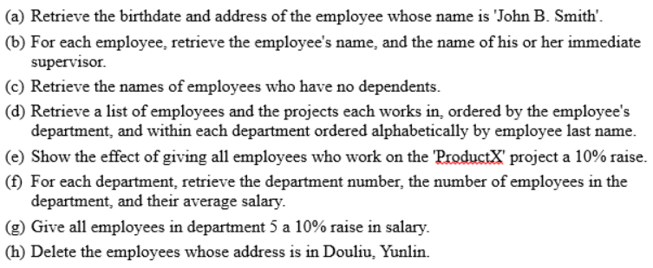

Slide 13

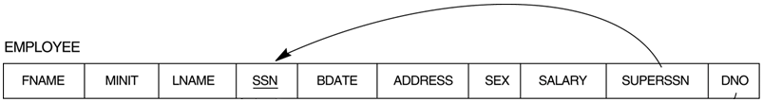
Simple SQL Queries
Basic SQL queries correspond to using the SELECT, PROJECT, and JOIN operations of the relational algebra
Example of a simple query on one relation
Query 0: Retrieve the birthdate and address of the employee whose name is 'John B. Smith'.
Q0: SELECT BDATE, ADDRESS FROM EMPLOYEE WHERE FNAME='John' AND MINIT='B' AND LNAME='Smith'
Similar to a SELECT-PROJECT pair of relational algebra operations; the SELECT-clause specifies the projection attributes and the WHERE-clause specifies the selection condition
However, the result of the query may contain duplicate tuples

Slide 14
ALIASES
Some queries need to refer to the same relation twice
In this case, aliases are given to the relation name
Query 8: For each employee, retrieve the employee's name, and the name of his or her immediate supervisor. Q8: SELECT E.FNAME, E.LNAME, S.FNAME, S.LNAME FROM EMPLOYEE E S WHERE E.SUPERSSN=S.SSN
In Q8, the alternate relation names E and S are called aliases or tuple variables for the EMPLOYEE relation
We can think of E and S as two different copies of EMPLOYEE; E represents employees in role of supervisees and S represents employees in role of supervisors
Aliasing can also be used in any SQL query for convenience Can also use the AS keyword to specify aliases
Q8: SELECT E.FNAME, E.LNAME, S.FNAME, S.LNAME FROM EMPLOYEE AS E, EMPLOYEE AS S WHERE E.SUPERSSN=S.SSN
E
S

Slide 15
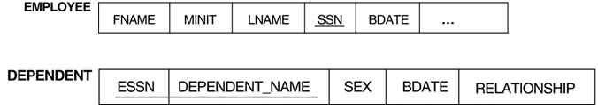
THE EXISTS FUNCTION
Query 6: Retrieve the names of employees who have no dependents. Q6: SELECT FNAME, LNAME FROM EMPLOYEE WHERE NOT EXISTS ( SELECT * FROM DEPENDENT WHERE SSN=ESSN)
In Q6, the correlated nested query retrieves all DEPENDENT tuples related to an EMPLOYEE tuple. If none exist , the EMPLOYEE tuple is selected
EXISTS is necessary for the expressive power of SQL
123

Slide 16
ORDER BY
The ORDER BY clause is used to sort the tuples in a query result based on the values of some attribute(s)
Query 15: Retrieve a list of employees and the projects each works in, ordered by the employee's department, and within each department ordered alphabetically by employee last name. Q15: SELECT DNAME, LNAME, FNAME, PNAME FROM DEPARTMENT, EMPLOYEE, WORKS_ON, PROJECT WHERE DNUMBER=DNO AND SSN=ESSN AND PNO=PNUMBER ORDER BY DNAME, LNAME
The default order is in ascending order of values
Keyword DESC if we want a descending order;
Keyword ASC can be used to explicitly specify ascending order, even though it is the default

Slide 17
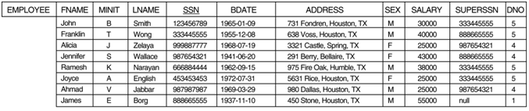
ARITHMETIC OPERATIONS
The standard arithmetic operators '+', '-'. '*', and '/' (for addition, subtraction, multiplication, and division, respectively) can be applied to numeric values in an SQL query result
Query 13: Show the effect of giving all employees who work on the 'ProductX' project a 10% raise. Q13: SELECT FNAME, LNAME, 1.1*SALARY FROM EMPLOYEE, WORKS_ON, PROJECT WHERE SSN=ESSN AND PNO=PNUMBER AND PNAME='ProductX’

Slide 18
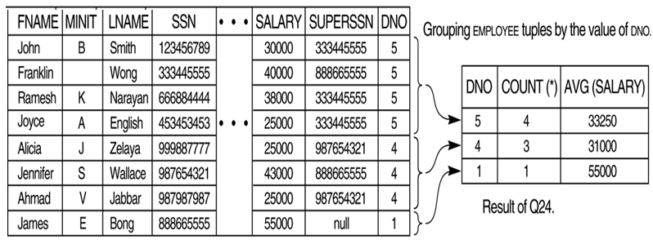
GROUPING (cont.)
Query 24: For each department, retrieve the department number, the number of employees in the department, and their average salary. Q24: SELECT DNO, COUNT (*), AVG (SALARY) FROM EMPLOYEE GROUP BY DNO
the EMPLOYEE tuples are divided into groups--each group having the same value for the grouping attribute DNO
The COUNT and AVG functions are applied to each such group of tuples separately
The SELECT-clause includes only the grouping attribute and the functions to be applied on each group of tuples

Slide 19
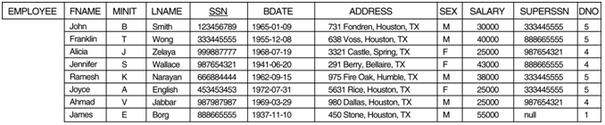
UPDATE (cont.)
Example: Give all employees in department 5 a 10% raise in salary. U6: UPDATE EMPLOYEE SET SALARY = SALARY *1.1 WHERE DNO = 5
In this request, the modified SALARY value depends on the original SALARY value in each tuple
The reference to the SALARY attribute on the right of = refers to the old SALARY value before modification
The reference to the SALARY attribute on the left of = refers to the new SALARY value after modification

Slide 20
DELETE (cont.)
U4C: DELETE FROM EMPLOYEE WHERE ADDRESS LIKE ‘%Douliu, Yunlin%'
A missing WHERE-clause specifies that all tuples in the relation are to be deleted; the table then becomes an empty table

